Slide 1
DSO106C - Machine Learning Lesson 1
Alison Schnoes

Slide 2
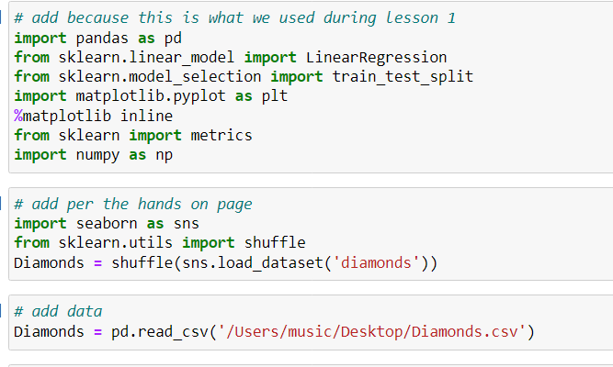
Load data packages and data csv into Jupyter Notebook

Slide 3
Directions from Hands On page
And use the following variables to predict the price of diamonds:
carat
cut
color
clarity
“You should be aware that in order to run this, you cannot have any non-number values in your dataset. If you do, and you attempt this step, you will end up with this error message: "ValueError: could not convert string to float: 'See notes for:" The “convert string to float” should tip you off that you have a problem with data types, and the “see notes for” section will tell you which variables are causing the error. You can either drop them out, or dummy code them into your dataframe - the choice is yours based on what variables you want to retain in your model.” from Create the Linear Regression Model page 3 Lesson 1 for the next 3 slides

Slide 4
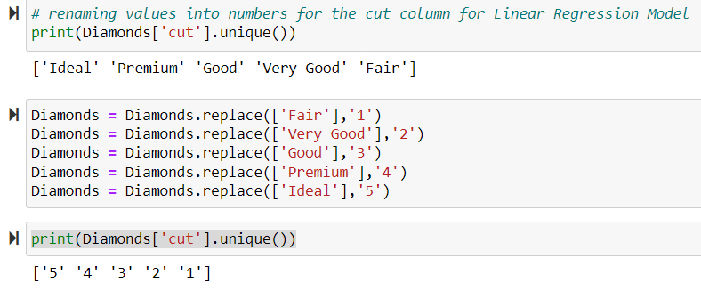
Renaming values into numbers for the cut, color, and clarity

Slide 5
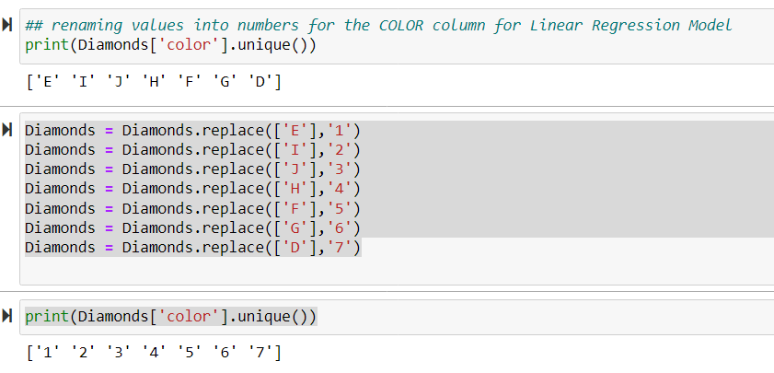
Renaming values into numbers for the cut, color, and clarity

Slide 6
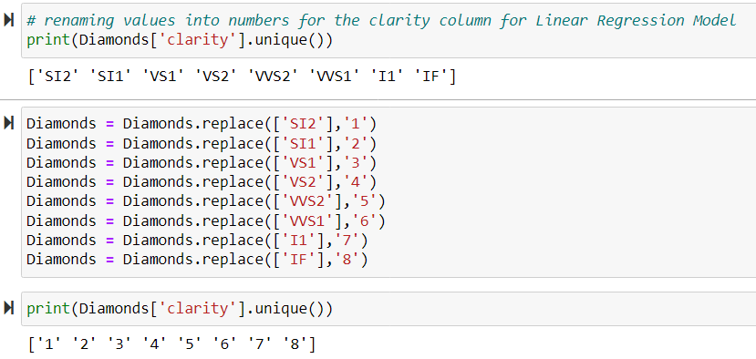
Renaming values into numbers for the cut, color, and clarity

Slide 7

Data Wrangling
The x data is the cut, carat, color, clarity columns from the data set.
The y data is the price column from the data set.
I did not use the # rows column, x, y, depth, table, and x columns because it was unclear what they were and/or not in the directions to use them.

Slide 8
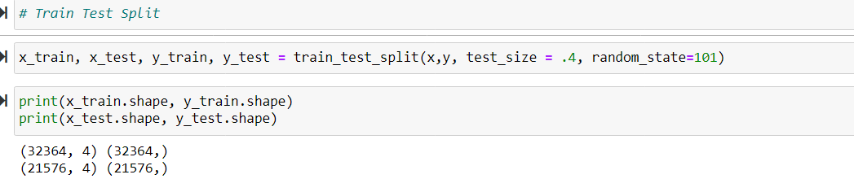
Train Test Split
Splitting the dataset using a 60/40 train/test split as in the textbook
Printing out the shape of the data that I was using for the machine learning algorithm. X_train was 32364 rows and 4 columns. X_test dataset is 21576 fires and 4 columns.

Slide 9
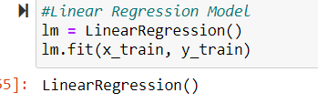
Linear Regression Model
The output of LinearRegression() let us know that it worked okay after redoing the 3 columns from characters into numbers.

Slide 10
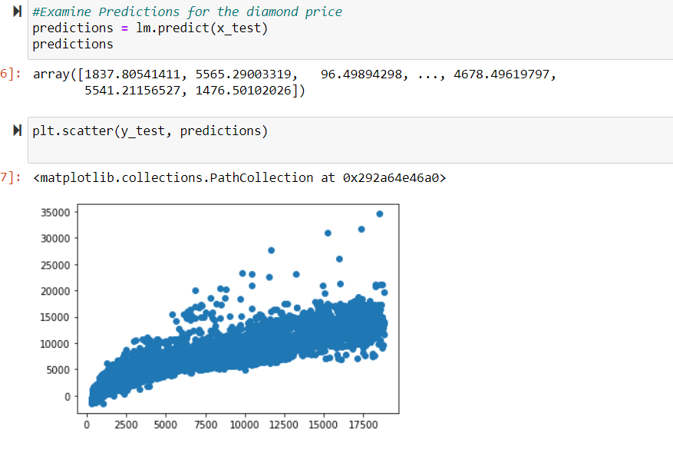
Examine Predictions
Using the array to plot the predictions of the model.
It is pretty straight for the line so the models fit.

Slide 11
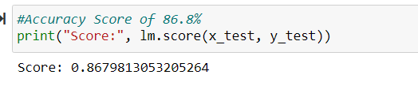
Accuracy Score of 86% of the time

Slide 12
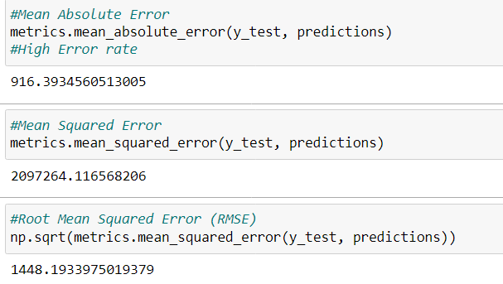
Errors
High Error Rate due to using dummy code to string data into numbers to make the linear regression work.

Slide 13
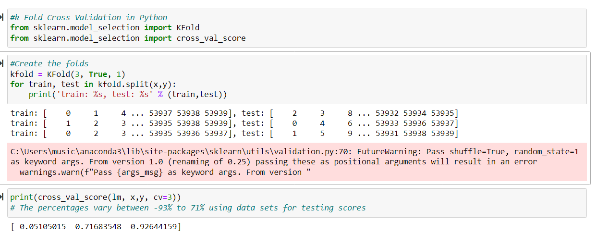
Cross Validation

Slide 14
Cross Validation
Import packages
Create the folds for training and test sets.
Print each set of train and test data and average together
The percentages vary between -93% to 71% using data sets for testing scores for the models

